Slide 1
Building network-tolerant PWAs
Now,
Now-Now,
and Just-Now:
@mikegeyser
#DevFestZA

Slide 2
Intro
@mikegeyser

Slide 3

@mikegeyser

Slide 4

Now
Immediately! Probably…
Just-Now
Now-Now
Later?
Maybe…
Soon!
Probably…
@mikegeyser

Slide 5
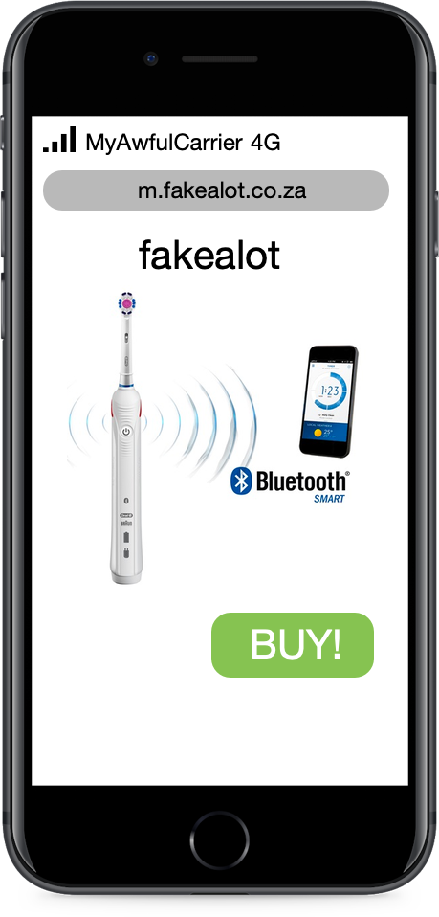

@mikegeyser

Slide 6
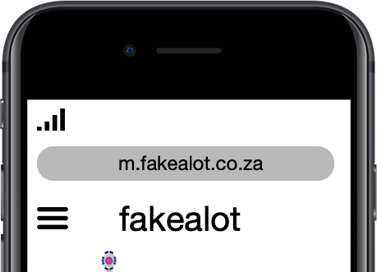
MyAwfulCarrier 4G
@mikegeyser

Slide 7
MyAwfulCarrier 3G
@mikegeyser

Slide 8
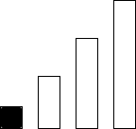
MyAwfulCarrier 3G
@mikegeyser

Slide 9
MyAwfulCarrier Edge
@mikegeyser

Slide 10
@mikegeyser

Slide 11
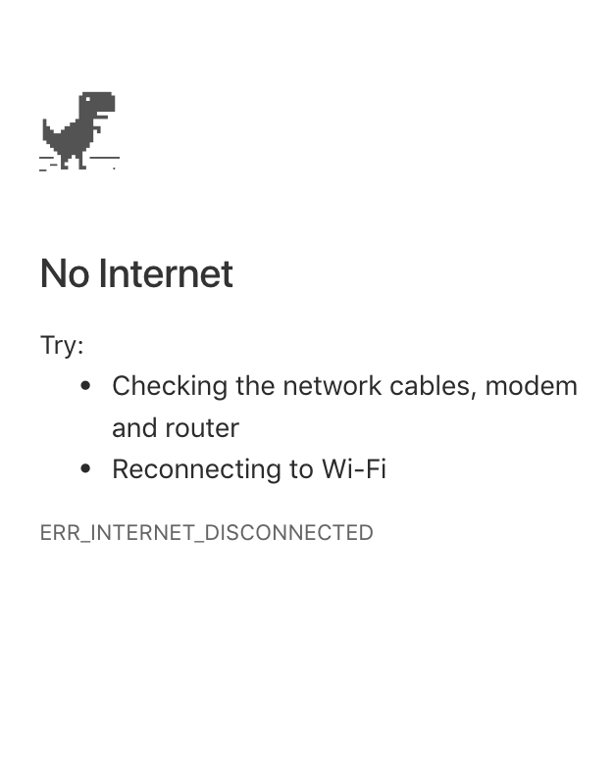
No Service
@mikegeyser

Slide 12

THIS IS WHY
WE CAN’T HAVE NICE THINGS

Slide 13
Network Tolerance
Partition tolerance
Network resilience
‘Offline first’
@mikegeyser

Slide 14
YOU KEEP USING THAT WORD
I DO NOT THINK IT MEANS WHAT
YOU THINK IT MEANS…

Slide 15
So, how do we do this?
@mikegeyser

Slide 16
Communicate state well
@mikegeyser

Slide 17

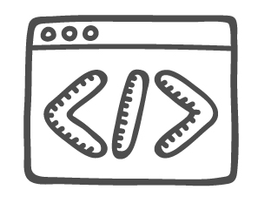

Service Worker
@mikegeyser

Slide 18


Slide 19
IndexedDB
@mikegeyser

Slide 20
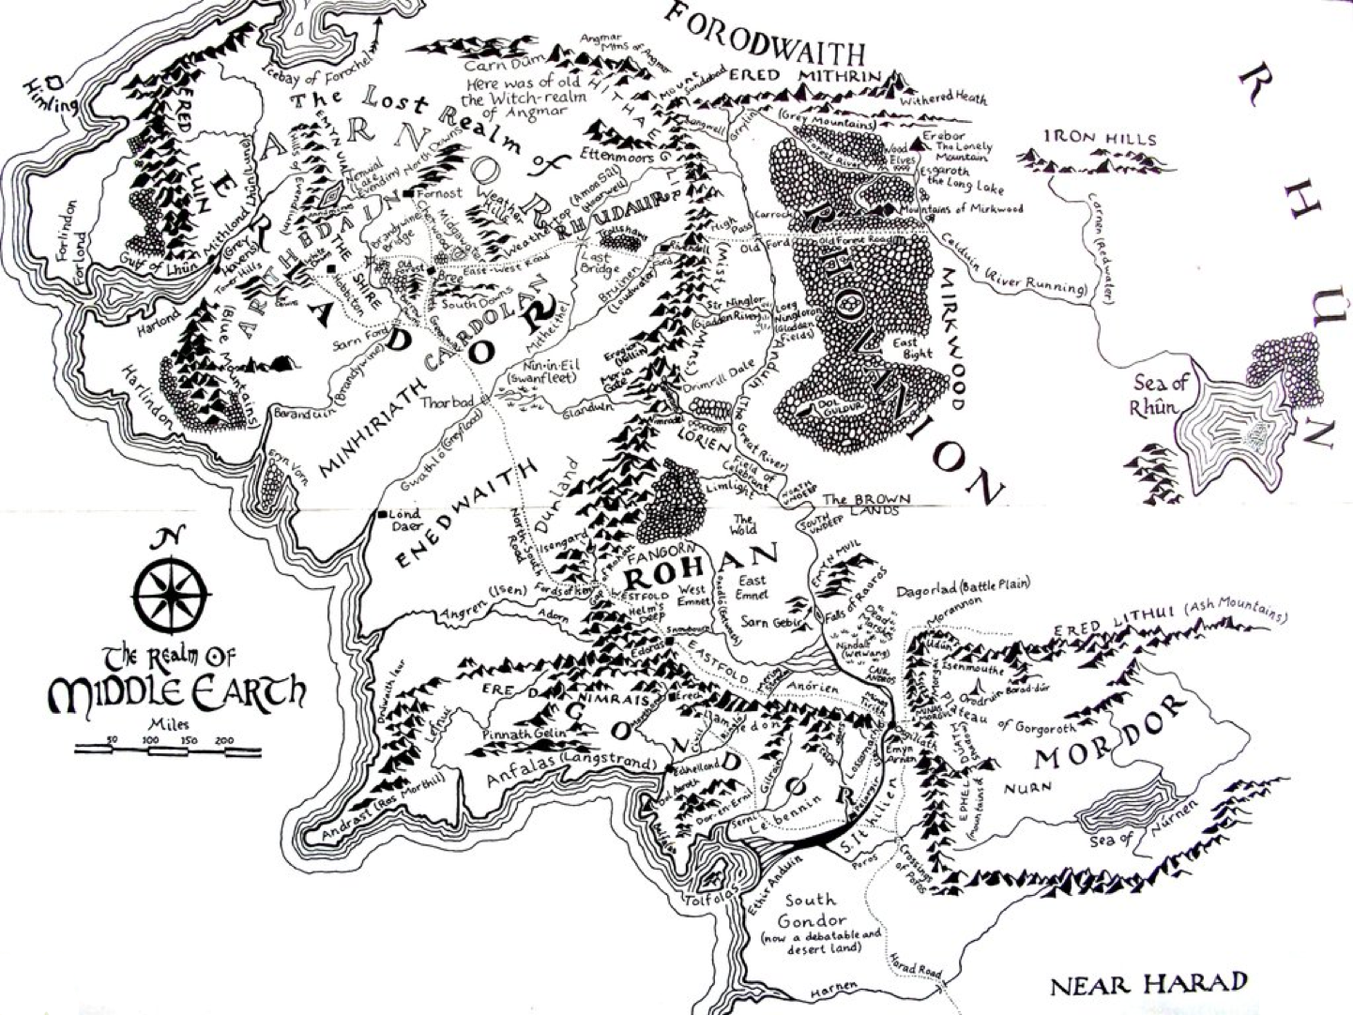

Slide 21

DEMO TIME

Slide 22
Summary
Capabilities
Expectations
Thoughtful design
Plan for offline
@mikegeyser

Slide 23
Questions?
@mikegeyser

